Slide 1
Information Security (BTCS06001)
By
Prof. Pranita Binnar (Research Scholar, Ph.D. Pursuing)
Visiting Faculty, Dept. of Computer Engineering
NMIMS, Navi Mumbai Campus
Email Contact – pranitasadgir@gmail.com
Contact No. - 9699502992

Slide 2
Myself
Ex-Scientific Officer, Cyber-Crime Forensic Lab, DFSL, Mumbai, GoM
CEH, CHFI Certified by EC-council, USA
PhD. Research Scholar research area Cyber security and Forensic
CTF Player in IT/OT Domain
Identifying vulnerability and reporting to respected vendor i.e Device VAPT.
02 best scientific research paper award securing 1st placed rank

Slide 3
Topics To Be Covered
Introduction
Security in Practices
Confidentiality
Integrity
Availability
Security violation and threats.

Slide 4
Learning Objectives
Describe the key security requirements of confidentiality, integrity and availability
Discuss the types security threats and attacks that must be dealt with
Summarize the functional requirements for computer security

Slide 5
Information hiding
Security
Applications
Negotiation
Privacy
Integrity
Access control
Threats
Data provenance
Biometrics
Semantic web security
Fraud
Trust
Policy making
Encryption
Computer epidemic
Data mining
Anonymity
Formal models
System monitoring
Vulnerabilities
Network security

Slide 6
Security in Practices- From CSI/FBI Report
90% detected computer security breaches within the last year
80% acknowledged financial losses
44% were willing and/or able to quantify their financial losses.
The most serious financial losses occurred through theft of proprietary information and financial fraud
34% reported the intrusions to law enforcement.
40% detected external penetration
40% detected denial of service attacks.
78% detected employee abuse of Internet access privileges
85% percent detected computer viruses.
38% suffered unauthorized access or misuse on their Web sites. [includes insider attacks]
12% reported theft of transaction information.
6% percent reported financial fraud

Slide 7
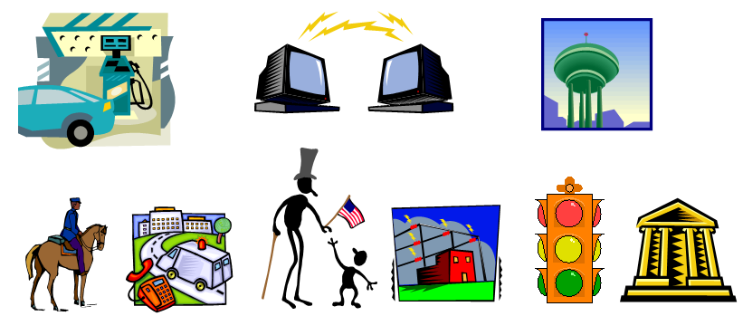
Critical Infrastructure Areas
Include:
Telecommunications
Electrical power systems
Water supply systems
Gas and oil pipelines
Transportation
Government services
Emergency services
Banking and finance
…

Slide 8
Introduction - Information Security
The protection of information and information systems from unauthorized access, use, disclosure, disruption, modification, or destruction in order to provide confidentiality, integrity, and availability. By NIST

Slide 9
What is a “Secure” Computer System?
To decide whether a computer system is “secure”, you must first decide what “secure” means to you, then identify the threats you care about.
You Will Never Own a Perfectly Secure System!
Threats(in Oval) - examples
Viruses, trojan horses, etc.
Denial of Service
Stolen Customer Data
Modified Databases
Identity Theft and other threats to personal privacy
Equipment Theft
Espionage/spying in cyberspace
Hack-tivism
Cyberterrorism
…
Cyberterrorism
Denial
of
Service
Modified
Databases
Virus
Espionage
Identity
Theft
Equipment
Theft
Stolen
Customer
Data

Slide 10
Basic Components of Security: Confidentiality, Integrity, Availability (CIA)
CIA
Confidentiality: Who is authorized to use data?
Integrity: Is data „good?”
Availability: Can access data whenever need it?
C
I
S
A
CIA or CIAAAN… ☺
(other security components added to CIA)
Authentication
Authorization
Non-repudiation
…
S = Secure
Ref: Security In Computing - Charles Pfleeger

Slide 11
Need to Balance CIA
Example 1: C vs. I+A
Disconnect computer from Internet to increase confidentiality
Availability suffers, integrity suffers due to lost updates
Example 2: I vs. C+A
Have extensive data checks by different people/systems to increase integrity
Confidentiality suffers as more people see data, availability suffers due to locks on data under verification)
Notes:
In addition to all the rules and regulations, policies and procedures and the related system specific documentation, there are some current computer security issues of which you as the Executive should be made aware.

Slide 12
Confidentiality
“Need to know” basis for data access
How do we know who needs what data?
Approach: access control specifies who can access what
How do we know a user is the person she claims to be?
Need her identity and need to verify this identity
Approach: identification and authentication
Analogously: “Need to access/use” basis for physical assets
E.g., access to a computer room, use of a desktop i.e Confidentiality - concered with access to assets
Confidentiality
Data confidentiality: Assures that confidential information is not disclosed to unauthorized individuals
Privacy: Assures that individual control or influence what information may be collected and stored

Slide 13
Risks
Types Of Risk
Legal Risks
Fines, liability lawsuits, criminal prosecution
Financial Risks
Numerous costs involved including losing customer's trust, legal fees, fines
Reputational Risks
Loss of trust
Operational Risks
Failed internal processes – insider trading, unethical practices, etc.
Strategic Risks
Financial institutions future, mergers, etc.

Slide 14
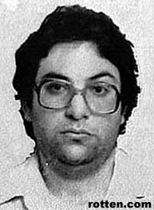
Threats to Confidentiality
Access to confidential information by any unauthorized person
Intercepted data transfers
Physical(HDD, Pendrive, etc) loss of data
Privileged access of confidential information by employees
Social engineered methods to gain confidential information
Transfer of confidential information to unauthorized third parties
Compromised machine where attacker is able to access data thought to be secure

Slide 15
Cont…
Scheduling information regarding national level speakers/sensitive private meetings highly restricted
Concerns over unauthorized access as a result of leaks – includes leaks to press as well as opposition/protest groups
Concerns over “leaks” via IT from opposition groups within the national organization
Loss of trust in decisions made at event
Can include public exposure of sensitive data

Slide 16
Cont…
Common theme: leaking private data
Strict access controls are crucial to protecting the confidential information
Those who should have access to the confidential information should be clearly defined
These people must sign a very clear confidentiality agreement
Should understand importance of keeping the information private

Slide 17
Integrity
Concerned with unauthorized modification of assets (= resources)
Integrity
Data integrity: assures that information and programs are changed only in a specified and authorized manner
System integrity: Assures that a system performs its operations in unimpaired manner(Not weakened or damaged)

Slide 18
Availability
Availability: assure that systems works promptly and service is not denied to authorized users

Slide 19
Revision
What is Information Security?
What are the Key elements of security?
Explain the key elements ?
What is the threads ? List some threads

Slide 20
Vulnerabilities, Threats, and Controls
Understanding Vulnerabilities, Threats, and Controls
Vulnerability = a weakness in a security system (i.e., in procedures, design, or implementation), that might be exploited to cause loss or harm.
Threat = circumstances that have a potential to cause harm
-a potential violation of security
Controls = means and ways to block a threat, which tries to exploit one or more vulnerabilities.
How do we address these problems?
We use a control as a protective measure.
That is, a control is an action, device, procedure, or technique that removes or reduces a vulnerability.
[Pfleeger & Pfleeger]

Slide 21
Cont…
Relationship among threats, controls, and vulnerabilities:
A threat is blocked by control of a vulnerability.
To devise controls, we must know as much about threats as possible.

Slide 22
Visual explanation of basic access control terms
Notes:
Visual explanation of basic access control terms

Slide 23
Types of Threats
Notes:
This diagram shows threats categorized according to whether they are human-caused, malicious, or directed. These characteristics will affect security planning in important ways later.

Slide 24
Advanced Persistent Threat (APT)
APT is a special type of threat that has only been taken seriously by the broad security community over the past decade. In general, security experts believe that no one who becomes a high-priority target can truly be safe from APT.
Types of APT
Organized
Directed
Well financed
Patient
Silent
Notes:
APT is a special type of threat that has only been taken seriously by the broad security community over the past decade. In general, security experts believe that no one who becomes a high-priority target can truly be safe from APT.

Slide 25
Types of Attackers
Notes:
Each of these attacker types is associated with a different set of resources, capabilities, and motivations. Understanding the different types will help later in considering threats.

Slide 26
Attack
= exploitation of one or more vulnerabilities by a threat; tries to defeat controls
Attack may be:
Successful
resulting in a breach of security, a system penetration, etc.
Unsuccessful
when controls block a threat trying to exploit a vulnerability
[Pfleeger & Pfleeger]

Slide 27
Kinds of Threats
Kinds of threats:
Interception
an unauthorized party (human or not) gains access to an asset
Interruption
an asset becomes lost, unavailable, or unusable
Modification
an unauthorized party changes the state of an asset
Fabrication
an unauthorized party counterfeits(imitate something authentic, with the intent to steal, destroy, or replace the original,) an asset
[Pfleeger & Pfleeger]

Slide 28
Levels of Vulnerabilities / Threats
D) for other assets (resources)
including. people using data, s/w, h/w
C) for data
B) for software
A) for hardware
[Pfleeger & Pfleeger]

Slide 29
Topics to be covered
Security policy and procedure
Assumptions and Trust
Security Assurance
Implementation and Operational Issues
Security Life Cycle

Slide 30
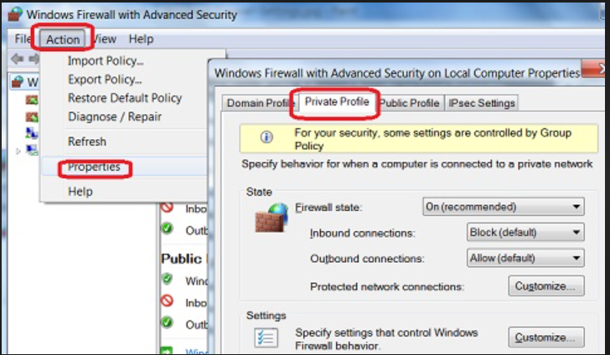
Security policy and Procedures
A security policy is a statement of what is, and what is not, allowed.
A security procedure is a method, tool, or mechanism for enforcing a security policy.
Mechanisms can be nontechnical,
such as requiring proof of identity
before changing a password;
in fact, policies often require
some procedural mechanisms that
technology cannot enforce.

Slide 31
Security policy and Procedures
Policies may be presented mathematically, as a list of allowed (secure) and disallowed (non secure) states.
In practice, policies are rarely so precise; they normally describe in English what users and staff are “allowed” to do or “disallowed” to do.
security policy’s specification of “secure” and “nonsecure” actions, these security mechanisms can prevent the attack, detect the attack, or recover from the attack.

Slide 32
Security policy and Procedures
Policy correctly divides world into secure and insecure states.
Mechanisms prevent transition from secure to insecure states.
The strategies may be used together or separately.
Prevention means that an attack will fail. For example, if one attempts to break into a host over the Internet and that host is not connected to the Internet, the attack has been prevented.

Slide 33
Example
Suppose a university’s computer science laboratory has a policy that prohibits any student from copying another student’s homework files.
The computer system provides mechanisms for preventing others from reading a user’s files.
Anna fails to use these mechanisms to protect her homework files, and Bill copies them.
A breach of security has occurred, because Bill has violated the security policy. Anna’s failure to protect her files does not authorize Bill to copy them.
In this example, Anna could easily have protected her files. In other environments, such protection may not be easy. For example, the Internet provides only the most rudimentary security mechanisms, which are not adequate to protect information sent over that network.
Notes:
Password , backdoor, bypass authentication

Slide 34
Assumptions and Trust
How do we determine if the policy correctly describes the required level and type of security for the site?
This question lies at the heart of all security, computer and otherwise.
Assumption Example
Opening a door lock requires a key. The assumption is that the lock is secure against lock picking. This assumption is treated as an axiom and is made because most people would require a key to open a door lock. A good lock picker, however, can open a lock without a key. Hence, in an environment with a skilled, untrustworthy lock picker, the assumption is wrong and the consequence invalid.
Notes:
Password example

Slide 35
Assumptions and Trust
Trust Example
If the lock picker is trustworthy, the assumption is valid. The term “trustworthy” implies that the lock picker will not pick a lock unless the owner of the lock authorizes the lock picking. This is another example of the role of trust.

Slide 36
Assurance
Evidence of how much to trust a system
Evidence can include
System specifications
Design
Implementation

Slide 37
Assurance
EXAMPLE: In the United States, aspirin from a nationally known and reputable manufacturer, delivered to the drugstore in a safety-sealed container, and sold with the seal still in place, is considered trustworthy by most people. The bases for that trust are as follows.
The testing and certification of the drug (aspirin) by the Food and Drug Administration(FDA).
The manufacturing standards of the company and the precautions it takes to ensure that the drug is not contaminated.
The safety seal on the bottle.
The three technologies (certification, manufacturing standards, and preventative sealing) provide some degree of assurance that the aspirin is not contaminated.
The degree of trust the purchaser has in the purity of the aspirin is a result of these three processes.

Slide 38
Assurance
Assurance in the computer world is similar. It requires specific steps to ensure that the computer will function properly.
The sequence of steps includes detailed specifications of the desired (or undesirable) behavior; an analysis of the design of the hardware, software, and other components to show that the system will not violate the specifications; and arguments or proofs that the implementation, operating procedures, and maintenance procedures will produce the desired behavior.

Slide 39
Specification
A specification is a (formal or informal) statement of the desired functioning of the system.
The specification can be low-level, combining program code with logical and temporal relationships to specify ordering of events.
EXAMPLE: A company is purchasing a new computer for internal use. They need to trust the system to be invulnerable to attack over the Internet. One of their (English) specifications would read “The system cannot be attacked over the Internet.”
Specifications are used not merely in security but also in systems designed for safety.

Slide 40
Design
The design of a system translates the specifications into components that will implement them.
The design is said to satisfy the specifications if, under all relevant circumstances, the design will not permit the system to violate those specifications.
EXAMPLE: A design of the computer system for the company mentioned above had no network interface cards, no modem cards, and no network drivers in the kernel. This design satisfied the specification because the system would not connect to the Internet. Hence it could not be attacked over the Internet.

Slide 41
Implementation
Given a design, the implementation creates a system that satisfies that design. If the design also satisfies the specifications, then by transitivity the implementation will also satisfy the specifications.
The difficulty at this step is the complexity of proving that a program correctly implements the design and, in turn, the specifications.
A program is correct if its implementation performs as specified.

Slide 42
Security Assurance
Furthermore, testing relies on test procedures and documentation, errors in either of which could invalidate the testing results.
Although assurance techniques do not guarantee correctness or security, they provide a firm basis for assessing what one must trust in order to believe that a system is secure.

Slide 43
Security Assurance
Trust cannot be quantified precisely.
System specification, design, and implementation can provide a basis for determining “how much” to trust a system. This aspect of trust is called assurance.
It is an attempt to provide a basis for bolstering (or substantiating
or specifying) how much one can trust a system.

Slide 44
Operational Issues
Any useful policy and mechanism must balance the benefits of the protection against the cost of designing, implementing, and using the mechanism. This balance can be determined by analyzing the risks of a security breach and the likelihood of it occurring.
Such an analysis is, to a degree, subjective, because in very few situations can risks be rigorously quantified.
Notes:
Aspirin, is a medication used to reduce pain, fever, or inflammation.

Slide 45
Cost-Benefit Analysis
If the data or resources cost less, or are of less value, than their protection, adding security mechanisms and procedures is not cost-effective because the data or resources can be reconstructed more cheaply than the protections themselves. Unfortunately, this is rarely the case.
EXAMPLE: A database provides salary information to a second system that prints checks. If the data in the database is altered, the company could suffer grievous financial loss; hence, even a cursory cost-benefit analysis would show that the strongest possible integrity mechanisms should protect the data in the database.

Slide 46
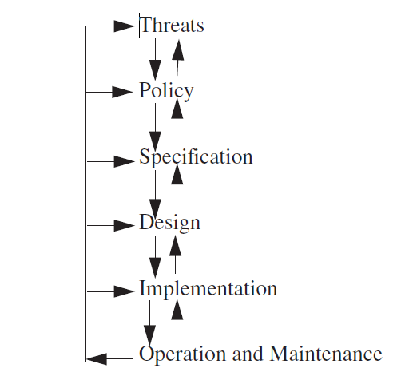
The security life cycle

Slide 47
Cont…
The operation and maintenance stage is critical to the
life cycle.
EXAMPLE: A major corporation decided to improve its security. It hired consultants, determined the threats, and created a policy.
From the policy, the consultants derived several specifications that the security mechanisms had to meet.
They then developed a design that would meet the specifications.
During the implementation phase, the company discovered that employees could connect modems to the telephones without being detected.
The design required all incoming connections to go through a firewall. The design had to be modified to divide systems into two classes: systems connected to “the outside,” which were put outside the firewall; and all other systems, which were put behind the firewall. The design needed other modifications as well.
When the system was deployed, the operation and maintenance phase revealed several unexpected threats.

Slide 48
Thank you

